Slide 1
Memory management, 80186, Virtual memory
Farhan Sadaf
Lecturer, Dept. of CSE

Slide 2
multiuser/multitasking OS
The basic principle of a timeshare system is that the CPU runs one user’s program for a few milliseconds, then runs the next user’s program for a few milliseconds and so on until all of the users have had a turn.
It cycles through the users over and over, fast enough that each user seems to have the complete attention of the CPU.
An operating system which coordinates the actions of a timeshare system such as this is referred to as a multiuser operating system.
The program or section of a program for each user is referred to as a task or process, so a multiuser operating system is also commonly referred to as multitasking OS.

Slide 3
Memory management
There are two major reasons why memory must be specially managed in a multitasking operating systems.
First reason is that the physical memory is usually not large enough to hold the operating system and all of the application programs that are being executed by the different users.
The second reason is to make sure that executing tasks do not access protected areas of memory.

Slide 4
Memory management
Some memory management can be done by the operating system software, but complete memory management and protection require the aid of hardware called a memory-management unit or MMU.
Other methods are also used to solve the limited memory problems.
Such methods are overlays and bank switching.

Slide 5
overlays
A common problem in single-user systems is that the physical memory is not large enough to hold, for example an assembler and the program being assembled.
The traditional solution is to write assembler in modules and use an overlay scheme.
When the assembler is invoked, the executive module of the assembler is loaded into memory, and the additional block of memory space called the overlay area is reserved for the assembler.
The first module of the assembler is loaded into the overlay area.

Slide 6
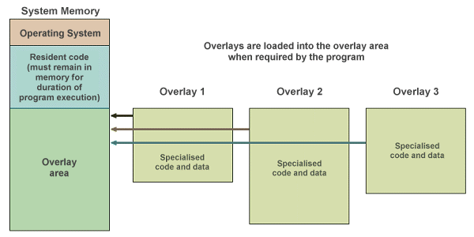
overlays

Slide 7
overlays
When the assembler reaches a point where it needs the next module, it reads that module, referred to as an overlay, from the disk into the overlay area reserved in memory.
When the assembler reaches a point where it needs another overlay, it reads that overlay from disk and loads it into the same overlay area in memory.
The overlay approach is commonly used in with assemblers, compilers, word processors and spreadsheet programs.

Slide 8
Bank switching
Another approach traditionally used to expand the available memory in a microcomputer is bank switching.
Intel 8085 has only 16 address lines, so they can directly address only 64 Kbytes of memory.
The figure on the next slide shows how the amount of memory can be expanded beyond the address limit.
The hardware is configured so that when the power is first turned on, the 16-Kbytes bank labeled bank 0 is enabled.

Slide 9
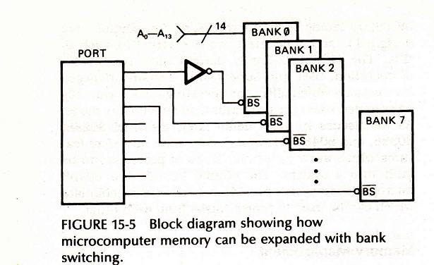
Bank switching

Slide 10
Bank switching
Let’s assume that this bank occupies system address space 4000H-7FFFH and that system address lines A0-A13 are used to address the bytes in this bank.
To switch to bank 1, a byte which turns off bank 0 and turns on bank 1 is output to the selection port.
The bank 1 devices now occupy the address space 4000H-7FFFH and system address lines A0-A13 are used to address the bytes in this bank.
Any of the other banks can be switched into the 4000H-7FFFH memory window by simply sending the appropriate word to the control port.

Slide 11
80186
Year of introduction 1982
16-bit microprocessor upgraded version of 8086
1MB of memory
Contained special hardware like programmable counters, interrupt controller, DMA controller etc.
Ideal for systems that required a minimum of hardware
NMOS technology
Number of transistors 29,000

Slide 12
Basic block diagram
Bus Interface Unit (BIU).
Execution Unit (EU).
Clock generator.
Programmable Interrupt Controller.
Programmable Timers.
Programmable DMA (Direct Memory Access) controller.
Programmable Chip Selection Unit

Slide 13
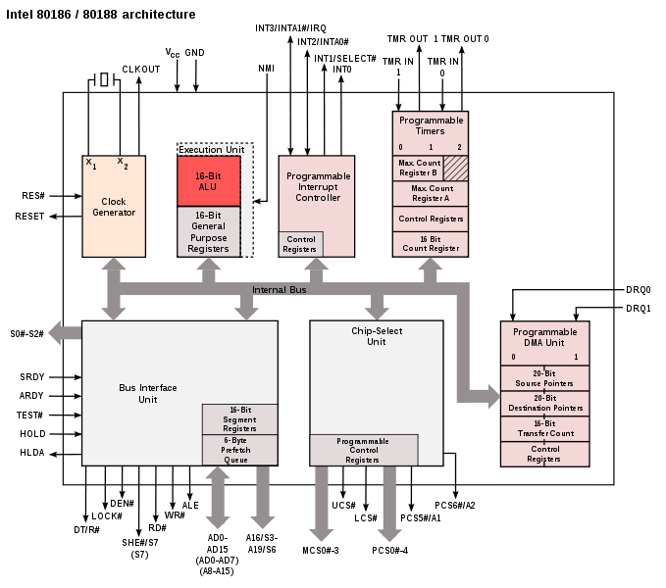

Slide 14
Basic Features
Clock Generator
The processor provides an internal clock generator for both internal and external clock generation. It replaces external clock generator 8284A used with the 8086/8088 microprocessors. This reduces the component count in a system.

Slide 15
Programmable Interrupt Controller
The 80186 can receive interrupts from a number of sources, both internal and external.
The Interrupt Control Unit (ICU) serves to merge these requests on a priority basis, for individual service by the CPU.
Internal interrupt sources include the Timers and DMA channels.
External interrupt sources come from the input pins INT.
The NMI interrupt pin is not controlled by the ICU and is passed directly to the CPU.
Each interrupt source can be independently masked by the ICU or all interrupts can be globally masked by the CPU.

Slide 16
Programmable Timers
The 80186 Timer/Counter Unit provides three 16-bit programmable timers.
Two of these (Timer 0 or Timer 1) are highly flexible and are connected to external pins for external use.
A third timer (Timer 2) is not connected to any external pins and can only be clocked internally.
However, it can be used to clock the other two timer channels.

Slide 17
Programmable DMA Controller
The 80186 DMA Control Unit provides two or four independent high-speed DMA channels.
Data transfers can occur between memory and I/O space in any combination: memory to memory, memory to I/O, I/O to I/O or I/O to memory.
Each data transfer consumes two bus cycles(a minimum of eight clocks), one cycle to fetch data and the other to store data.

Slide 18
Programmable Chip Select Unit
The 80186 Chip-Select Unit integrates logic which provides up to 13 programmable chip selects to access both memories and peripherals.
It has 6 output lines to select memory and 7 output lines to select I/O.

Slide 19
Power Save/ Power Down feature
Power Save Mode divides the processor clock by 4, 8 or 16 to reduce power consumption.
It is started by software and exited by hardware event such as an interrupt.
Power down mode stops the clock completely
Power down mode is entered by executing a HLT instruction and exited by an interrupt.

Slide 20
Virtual memory
Memory is hardware that your computer uses to load the operating system and run programs.
It consists of one or more RAM chips that each have several memory modules.
Computer has a finite amount of RAM, it is possible to run out of memory when too many programs are running at one time.
This is where virtual memory comes in.
Virtual memory increases the available memory your computer has by enlarging the "address space," or places in memory where data can be stored.

Slide 21
Virtual memory
It does this by using hard disk space for additional memory allocation.
However, since the hard drive is much slower than the RAM, data stored in virtual memory must be mapped back to real memory in order to be used.
The process of mapping data back and forth between the hard drive and the RAM takes longer than accessing it directly from the memory.
While virtual memory enables your computer to run more programs than it could otherwise, it is best to have as much physical memory as possible.

Slide 22
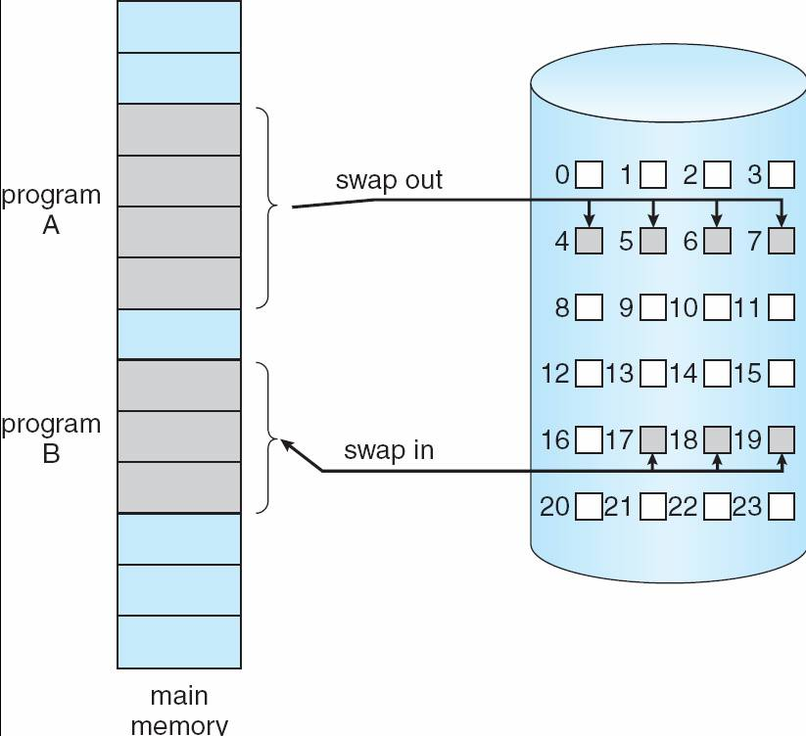
Virtual memory

Slide 23
The 80186 has 20-bit address lines and is able to access 2²⁰ = 1MB memory. The 80186 was an advanced version of the 8086 but did not include support for virtual memory. The 80286 was the first Intel CPU to support virtual memory but it's capabilities were limited.
Virtual memory
Notes:
https://www.eeeguide.com/difference-between-80186-and-80286-microprocessor/

Slide 24
Virtual memory can be implemented via: – Demand paging – Demand segmentation

Slide 25
Virtual memory
- Demand paging
• Bring a page into memory only when it is needed. – Less I/O is needed – Less memory is needed – Faster response – More users • Page is needed ⇒ Reference to it – Invalid reference ⇒ Abort – Not-in-memory ⇒ Page fault. Bring to memory

Slide 26
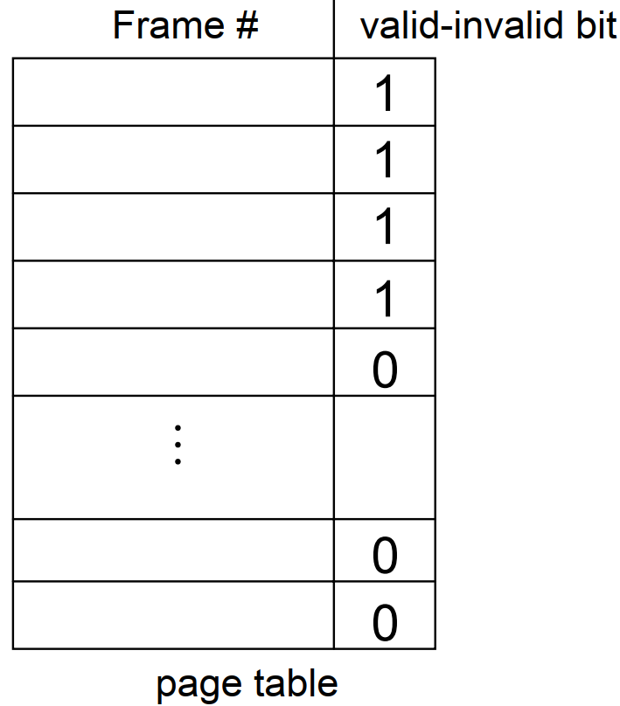
Virtual memory
- Demand paging
Valid-Invalid Bit • With each page table entry a valid–invalid bit is associated (1 ⇒ in-memory, 0 ⇒ not-in-memory) • Initially valid–invalid bit is set to 0 on all entries. • During address translation, if valid–invalid bit in page table entry is 0 ⇒ page fault.

Slide 27
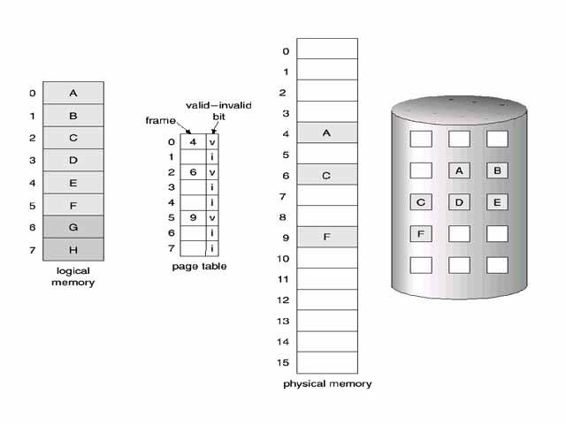
Virtual memory
- Demand paging
Figure: Page Table When Some Pages Are Not in Main Memory

Slide 28
Virtual memory
Virtual memory can be managed totally by the operating system, but most microcomputer systems use a hardware device called a memory management unit or MMU to assist in the process.
How the MMUs in the 80286, 80386 and 80486 processors manage segment-based virtual memory?

Slide 29
Virtual memory
Logical address: the address you work with in a program are called logical address.
Logical address indicates the logical positions of code and data.
An example of this is the 8086 instruction JNZ NEXT.
The level NEXT represents a logical address that execution will go to if the zero flag is not set.
When an 8086 program is assembled, each logical address is represented with a 16-bit offset and a 16-bit segment base.
The 8086 BIU then produces the actual physical memory address by simply adding these two parts together.

Slide 30
Virtual memory(MMU)
- Demand segmentation
When a program is assembled or compiled to run on a system with an MMU, each logical or virtual address is also represented by two components, but the components function differently.
In a segment-oriented system such as an 80286, the upper 16-bit component is referred to as a segment selector and the lower component is referred to as the offset.
MMU uses the segment selector to access a descriptor for the desired segment in a table of descriptors in memory.
A descriptor is a series of memory locations that contain the physical base address for a segment, the privilege level of the segment and some control bits.

Slide 31
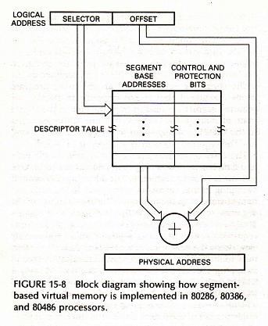
Virtual memory
- Demand segmentation

Slide 32
Virtual memory
- Demand segmentation
The selector for the 80286,80386 and 80486 have 14 address bits and 2 privilege-level bits.
The 14 address bits in the selector can select any one of 16384 descriptors in the descriptor table.
Since each descriptor represents a segment, this means that a program can access up to 16384 segments.
For an 80286 the offset part of the virtual address is 16 bits, so each segment can contain up to 64 Kbytes.
The logical or virtual address space accessible by an 80286 then is 16384 segments X 65536 bytes/segment, or 1 Gbyte.

Slide 33
Virtual memory
When the MMU receives a logical address from the CPU, it checks to see if that segment is currently in the physical memory.
If the segment is present in physical memory, the MMU adds the offset component of the address to the segment base component of the address from the segment descriptor to form the physical address.
It then outputs the physical address to memory on the memory address bus.
If the MMU finds that the segment specified by the selector part of the logical address is not in memory, it sends an interrupt signal to the CPU.

Slide 34
Virtual memory
In response to the interrupt, the operating system executes an interrupt procedure which reads the desired code or data segment from disk and loads in into the physical memory.
The MMU then computes and outputs the physical address.

Slide 35
Virtual memory summary
An MMU is used to manage virtual memory.
The MMU uses a descriptor table to translate logical or virtual program addresses to physical addresses.
This indirect approach makes possible a virtual address space much larger than the physical address space.
The indirect approach also makes it possible to protect a memory segment from access by a program section with a lower privilege level.

Slide 36
Thank You

